Slide 1
Elderly Care
SUBMITTED BY:-
1. CHINMAYEE KULKARNI- 210943120045
2. SHRADDHA INAMDAR-210943120093
3. TASLEEM NADAF-210943120058
4. NAMRATA VIDHATE-210943120115

Slide 2
INTRODUCTION
Senior family members require more attention and care, which you and
your family members may not be able to provide due to work or other
commitments.
Most elders are reluctant to say or admit that they need help even if they
are no longer capable of taking care of themselves properly. However, there are
certain signs or tells whenever your elders already need help and attention in his
or her life.
For this reason, hiring professionals to provide general service for your
elders is the best solution to ensure that your elderly loved ones are taken care
of properly and their health is consistently monitored for their safety and well
Being.

Slide 3
MODULES
1.Login
2.Assistant
3.Emergency Doctor
4. Product
5.Meal

Slide 4
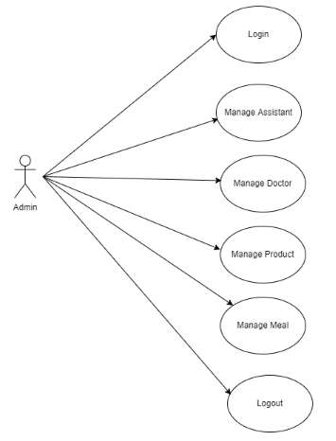
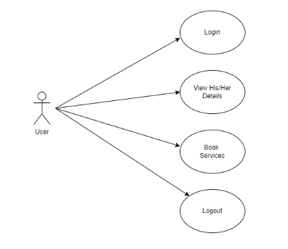
USER CASE DIAGRAM

Slide 5
TOOLS AND TECHNOLOGIES
TECHNOLOGIES USED
• Spring-Boot
• React-JS
• MySQL
DEVELOPMENT TOOLS
• Visual Studio Code
• Spring Tool Suite
• MySQL Relational Database

Slide 6
FUTURE SCOPE
1.Palliative Care.
2.Complaints and feedback system.
3.Chatbot.
4.UI related Changes as per customer requirement.

Slide 7
CONCLUSION
In today’s fast growing and busy world ,every Person looks for an easy convenient and at the same time professional healthcare and Elderly care services for their loved ones.Finding everything at one spot is the main thing which everyone looks for in today’s busy life.Providing trusted quality service was the main motto of Elderly Care management system ,so we came up with this idea as our platform provides major facilities like Healthy and Customised meal, Orthopaedic/Seniority Product, Assistant if you need assistance,Healthcare professionals such as doctors at one stop .We hope this platform will help users find everything they need about elderlycare ,Working on this project was fun and insightful at the same time as we got to learn a lot of thing about spring.

